Slide 1
BLOCKCHAIN & WEB 3.0

Slide 2
INTRODUCTION
What is a Blockchain?
Blockchain is a shared, immutable ledger that facilitates the process of recording transactions and tracking assets in a business network.
Key elements of a Blockchain:-
Distributed Ledger Technology
Immutable Records
Smart Contracts

Slide 3
INTRODUCTION
WHAT IS WEB 3.0 ?
Web 3.0 describes the next evolution of the World Wide Web, the user interface that provides access to documents, applications, and multimedia on the internet.
Web 3.0 will place a strong emphasis on decentralized applications and probably make extensive use of blockchain technologies. It will also use machine learning and AI to empower a more intelligent and adaptive web.

Slide 4
INTRODUCTION
Non – Fungible Token (NFT) ?
Non – fungible token (NFTs) are assets like a piece of art, digital content, or video that have been tokenized via a blockchain. Tokens are unique identification codes created form metadata via an encryption function.
These tokens are then stored on a blockchain, while the assets themselves are stored in other places. The connection between the token and the asset is what makes them unique.

Slide 5
PROBLEM STATEMENT
NFT Marketplace for digital Art :
To design and develop a decentralized platform for buying, selling and trading digital art using the NFT’s (Non-Fungible tokens) on a blockchain network.

Slide 6
APPROACH TO SOLVE THE PROBLEM
This project focuses on developing and deploying a decentralized application (DApp) powered by blockchain technology for buying, selling and trading digital art using NFT’s
We have created a platform by using the Goerli test net with a help of a node service provider namely Alchemy. We have designed a user friendly interface that is intuitive for the users who may not be familiar with the blockchain technology. We have integrated MetaMask in this project which is a renowned cryptocurrency wallet.

Slide 7
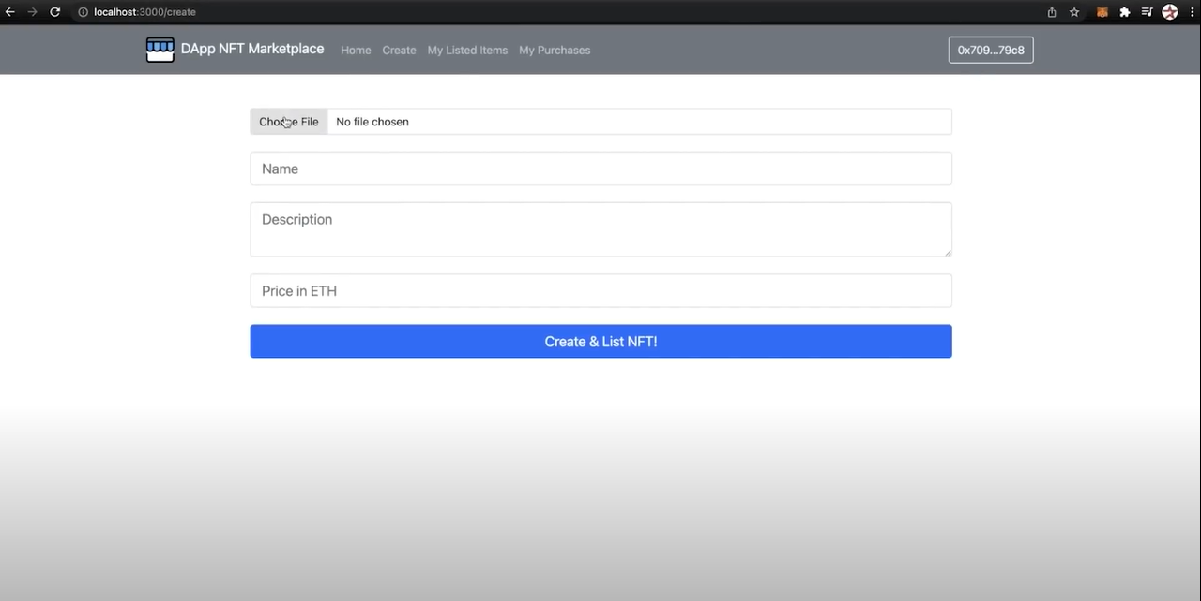
MAIN WEB PAGE

Slide 8
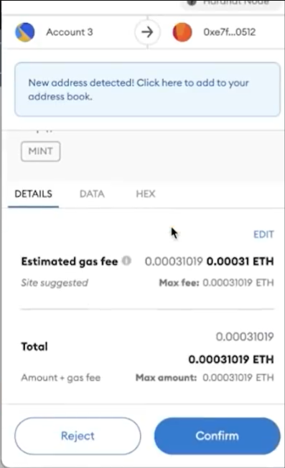
MetaMask Integration
We have to setup the MetaMask wallet for buying and selling NFT’s.

Slide 9
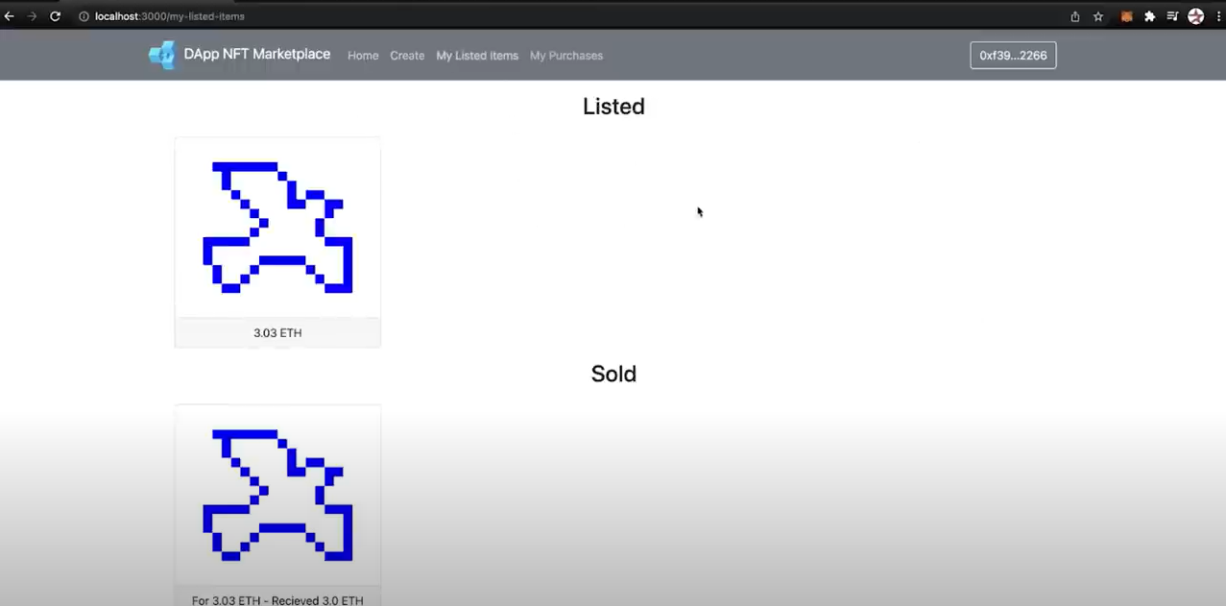
FINAL OUTCOME OF THE PROJECT

Slide 10
THANK YOU
BY THE TEAM:
INNOVATORS

